Slide 1
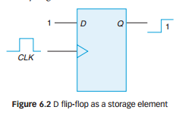
Shift Registers
A register that is capable of shifting its binary data in one or both directions (left and right) is called a shift register.
Shift registers are actually a type of sequential logic circuit, mainly for storage of digital data.
They are a group of flip-flops connected in a chain so that the output from one flip-flop becomes the input of the next flip-flop.
Most of the registers possess no characteristic internal sequence of states.
All the flip-flops are driven by a common clock, and all are set or reset simultaneously.

Slide 2
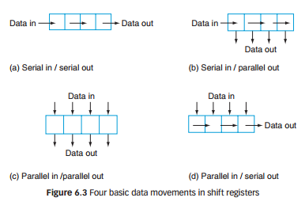
6.1 Shift Registers

Slide 3
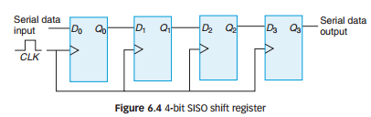
Chapter 6 : Registers
6.1 Shift Registers
6.1.1 Serial In/Serial Out Shift Register (SISO)
In a SISO register, data is entered and read in serial fashion. Let’s examine the basic 4-bit SISO implemented by D flip-flops as in Figure 6.4. Please note that with 4 flip-flops for 4 stages, this register can store up to four bits of data.

Slide 4
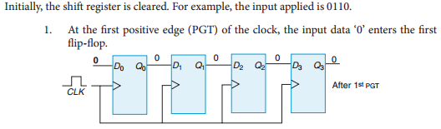
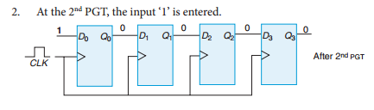
Chapter 6 : Registers
6.1 Shift Registers

Slide 5
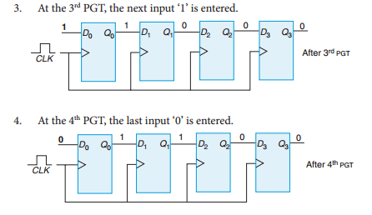
Chapter 6 : Registers
6.1 Shift Registers

Slide 6
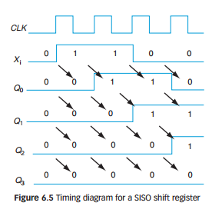
Chapter 6 : Registers
6.1 Shift Registers

Slide 7
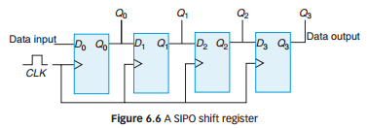
Chapter 6 : Registers
6.1 Shift Registers
6.1.2 Serial In/Parallel Out Shift Register (SIPO)
In a SIPO shift register, the data is entered into a register in serial fashion, similar to SISO.
The difference is only in the way in which the data is read or taken out from the register, which is parallel.
Once all the data have been stored serially, each bit appears on its respective output line, and are all available simultaneously.
The clock is not required to read the data and the data is retained even after the read operation.

Slide 8
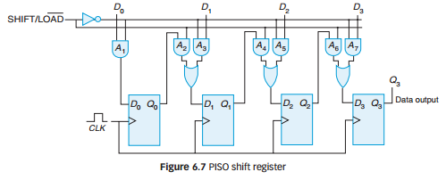
Chapter 6 : Registers
6.1 Shift Registers
6.1.3 Parallel In/Serial Out Shift Register (PISO)
In a PISO shift register, all the data are entered simultaneously into their respective stages in parallel rather than bit-by-bit.
After that, the data is shifted out serially from the register.

Slide 9
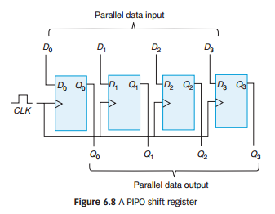
Chapter 6 : Registers
6.1 Shift Registers
6.1.4 Parallel In/Parallel Out Shift Register (PIPO)
In a PIPO shift register, the data is entered and read in parallel fashion.
Both enter and read style has been discussed previously.

Slide 10
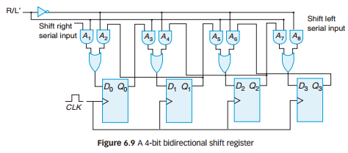
Chapter 6 : Registers
6.1 Shift Registers
6.1.5 Bidirectional Shift Register
In a bidirectional shift register, the data is shifted in both directions, left and right.
The direction is controlled by the control input R/L’ .

Slide 11
Chapter 6 : Registers
6.1 Shift Registers
Shift Left Registers as Multiplier Circuits
For multiplying purposes, data is shifted to the left side by the amount of n bits with input that is always 0.
For example, consider the number loaded in the shift register is 0001, which has to be multiplied by 4 = 2².
00010001 x 2 = 0010 shifted left by 1 bit 0001 x 2² = 0100 shifted left by 2 bits.
Notice that the MSB is lost.

Slide 12
Chapter 6 : Registers
6.1 Shift Registers
Shift Right Registers as Divider Circuits
For dividing purposes, the data is shifted to the right by the amount of n bits with input that is always 0.
For example, consider the number loaded in the shift register is 1000, which has to be divided by 2².
Notice here that the LSB is lost.
1000
1000/2 = 0100 shifted right by 1 bit
1000/ 2² = 0010 shifted right by 2 bits

Slide 13
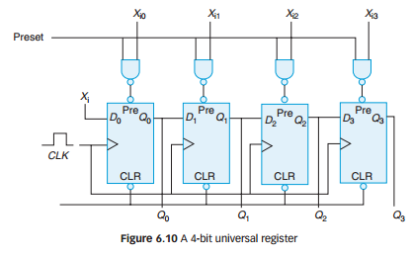
Chapter 6 : Registers
6.1 Shift Registers
6.1.6 Universal Register
The universal register operates in all four possible modes explained previously (SISO, SIPO, PISO and PIPO) and also the bidirectional shift register.

Slide 14
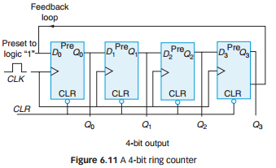
Chapter 6 : Registers
6.2 Shift Register Counters
6.2.1 Ring Counter
A ring counter is basically a circulating shift register in which the output of the most significant stage is fed back to the input of the least significant stage.
Figure 6.11 shows a 4-bit ring counter constructed from D flip-flops.
The output of each stage is shifted into the next stage on the positive edge of a clock pulse.
If the CLEAR signal is high, all the
flip-flops except the first one,
FF₀, are reset to 0.
FF₀ is preset to 1 instead.

Slide 15
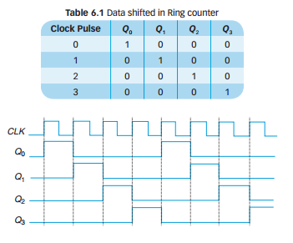
Chapter 6 : Registers
6.2 Shift Register Counters

Slide 16
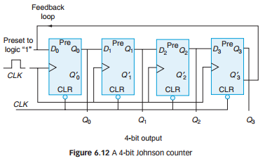
Chapter 6 : Registers
6.2 Shift Register Counters
6.2.2 Johnson Counter
Johnson counters are a variation of standard ring counters, with the inverted output of the last stage fed back to the input of the first stage.
They are also known as twisted ring counters.
An n-stage Johnson counter yields a count sequence of length 2^{n}, so it may be considered to be a mod-2^{n} counter.

Slide 17
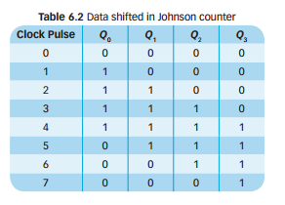
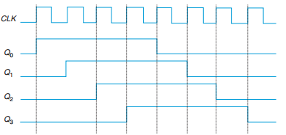
Chapter 6 : Registers
6.2 Shift Register Counters

Slide 18
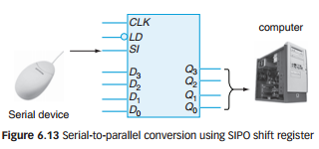
Chapter 6 : Registers
6.3 Applications of Shift Registers
6.3.1 Converting Serial Data to Parallel Data
A computer or microprocessor-based system usually requires incoming data to be in parallel format.
However, these systems must communicate with external devices that send or receive serial data regularly.
Thus, the serial-to-parallel conversion is required.
In receiving serial data, the serial device such as a keyboard or mouse is connected to the register’s SI input while the register’s outputs, Q₃ - Q₀ are connected to the computer as shown in Figure 6.13.

Slide 19
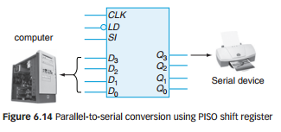
Chapter 6 : Registers
6.3 Applications of Shift Registers
6.3.2 Converting Parallel Data to Serial Data
On the other hand, PISO configuration is designed for the parallel input of a microprocessor or computer, to handle parallel data and convert it to serial data.
As shown in Figure 6.14, to send data serially, the CPU is connected to the register’s D inputs.
The shift output is connected to a serial device such as a printer.
The computer first stores a four-bit word in the register in one cycle.
After four cycles, the serial device can then read the shift output that appears on Q₃ in each clock cycle.

Slide 20
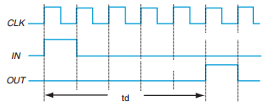
Chapter 6 : Registers
6.3 Applications of Shift Registers
6.3.3 Producing Time Delay
The SISO shift register can be used as a time delay device.
The amount of delay can be controlled by the number of stages in the register and the clock frequency.
This can be achieved by cascading shift registers.
For example, a 5-bit SISO shift register has a 50 MHz clock.
To calculate the total delay through the register, one has to find the delay for each clock first.
Figure 6.15 shows the time delay produced by cascading 5 SISO shift registers.
The delay for each clock, 1/50 MHz = 20 ns
The total delay is 5 ×20 ns = 100 ns

Slide 21


Chapter 6 : Registers
6.3 Applications of Shift Registers
6.3.4 Multiplication and Division
By shifting to the left, any binary number can be multiplied by powers of two.
A left shift by n is equivalent to multiplying by 2^{n}
On the other hand, by shifting any number to the right by n, it is equivalent to dividing by 2^{n}

Slide 22
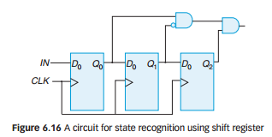
Chapter 6 : Registers
6.3 Applications of Shift Registers
6.3.5 State Recognition
Shift registers can also be used to recognize a specific binary number.
Sequences of bits are loaded in series into a register.
As shown in Figure 6.16, external detection gates are connected to the register, which will identify if the value matches the predetermined value or not.

Slide 23
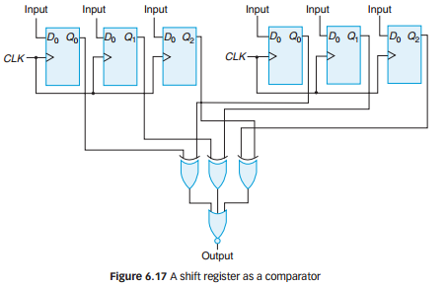
Chapter 6 : Registers
6.3 Applications of Shift Registers
6.3.6 Comparison of Two Values
Values stored in a shift register can be compared. This can be done by having the circuit as in Figure 6.17

Slide 24
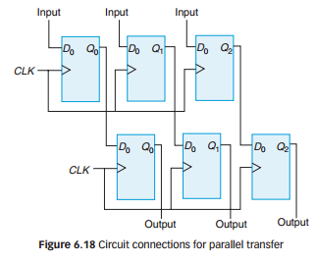
Chapter 6 : Registers
6.3 Applications of Shift Registers
6.3.7 Parallel Transfer
We can transfer the content of one register to another register by parallel transfer, as shown in Figure 6.18.

Slide 25
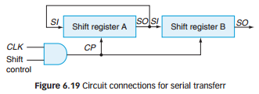
Chapter 6 : Registers
6.3 Applications of Shift Registers
6.3.8 Serial Transfer
We can also perform a serial transfer of data from one register to another register, as shown in Figure 6.19.

Slide 26
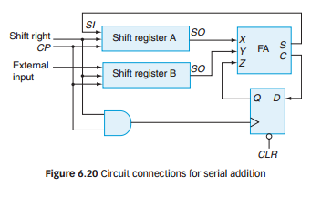
Chapter 6 : Registers
6.3 Applications of Shift Registers
6.3.9 Serial Addition
Serial addition uses less equipment, but it is a bit slower. Figure 6.20 shows how serial addition can be done.

Slide 27
Chapter 6 : Registers
6.3 Applications of Shift Registers
6.3.10 Data Storage
Previously, shift registers were used to store data in the CPU and clocked out into an arithmetic logic unit (ALU).
However, due to the high cost, random access memory (RAM) has replaced the shift registers.

Slide 28
Chapter 6 : Registers
Summary
The basic types of data movement in shift registers: serial in/serial out (SISO), serial in/parallel out (SIPO), parallel in/serial out (PISO) and parallel in/parallel out (PIPO).
Shift register counters are the Johnson Counter and Ring Counter, which exhibit special sequences in the feedback loop.
Applications of shift registers: Converting serial data to parallel data, converting parallel data to serial data, producing time delay, multiplication and division, state recognition, comparison of two values, parallel transfer, serial addition and data storage.

